Slide 1
JobConnect – Internship Project
DCRK IT Solutions Private Limited
Bhavitavya Isukapati
Web Development Intern
March 2025 – August 2025

Slide 2
About the Company
DCRK IT Solutions Pvt. Ltd. is a modern IT company that focuses on web and enterprise software development. It provides scalable, secure, and innovative digital solutions for clients and offers real-time project exposure to interns and trainees.

Slide 3
My Role & Responsibilities
- Role: Web Development Intern
- Design frontend using React.js & Tailwind CSS
- Develop backend using Node.js & Express
- Integrate MongoDB Atlas
- JWT-based authentication
- Email functionality with Nodemailer
- Admin and Profile page development

Slide 4
Project Overview – JobConnect
JobConnect is a full-stack job portal that connects job seekers with recruiters. It includes user registration, login, job listings, detailed job view, job application with email confirmation, admin dashboard for job management, and user profile handling.

Slide 5
Problem Statement
Job searching is often scattered and inefficient. Many portals lack features like application tracking and admin control. JobConnect solves this by providing a centralized platform with job listings, user applications, and admin functionality.

Slide 6
Objective of the Project
To develop a full-stack job portal using MERN stack that offers secure, role-based access for users and admins, supports job applications with email confirmation, and provides a professional and responsive UI/UX.

Slide 7
Technology Stack
- Frontend: React.js, Tailwind CSS
- Backend: Node.js, Express.js
- Database: MongoDB Atlas
- Auth & Mail: JWT, Nodemailer
- Tools: Postman

Slide 8
Website Flow
Home → Register/Login → View Jobs → Job Details → Apply → Email Confirmation → Profile Page → Admin Panel

Slide 10
Frontend: Home & Job Listings
- Modern UI with responsive design
- Job cards with 'View Details' buttons
- Tailwind CSS for consistent styling

Slide 11
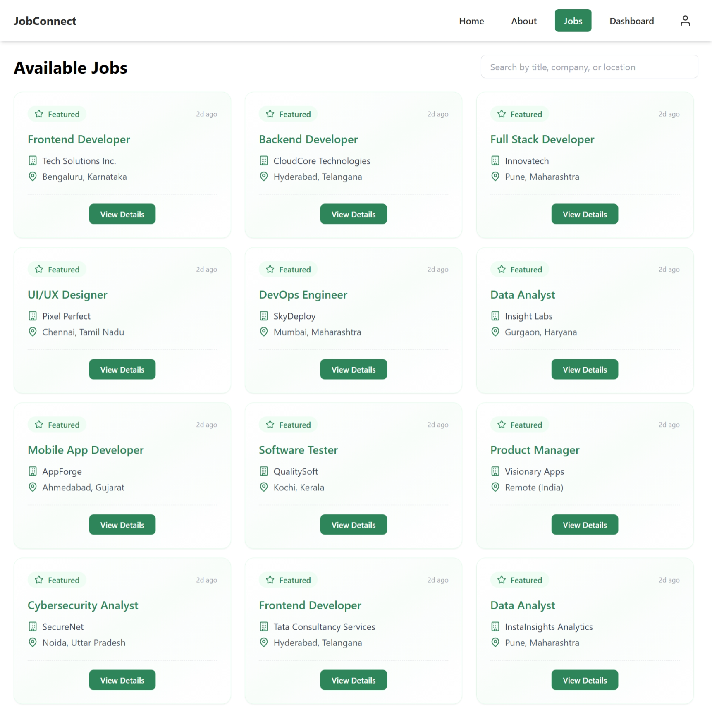

Slide 12
Job Details & Apply
- Individual job page with detailed descriptions
- Apply form with fields: Name, Email, Resume
- On submit: stores in DB and sends email via Nodemailer

Slide 13
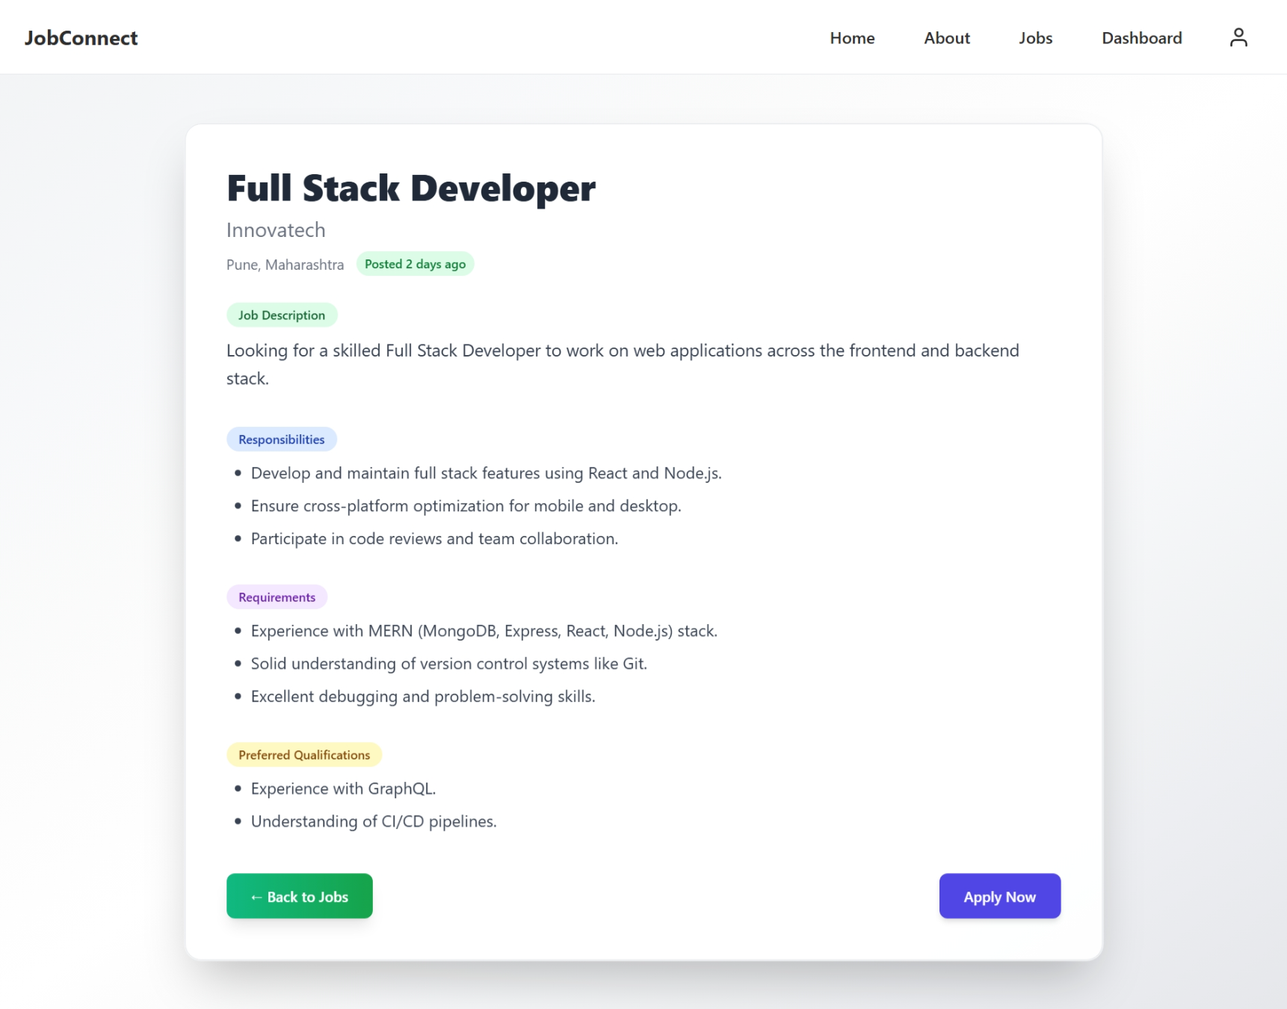

Slide 14
Authentication – Register/Login
- JWT-based login system
- User credentials stored securely
- Role-based redirect for users and admins
- Token stored in localStorage

Slide 15
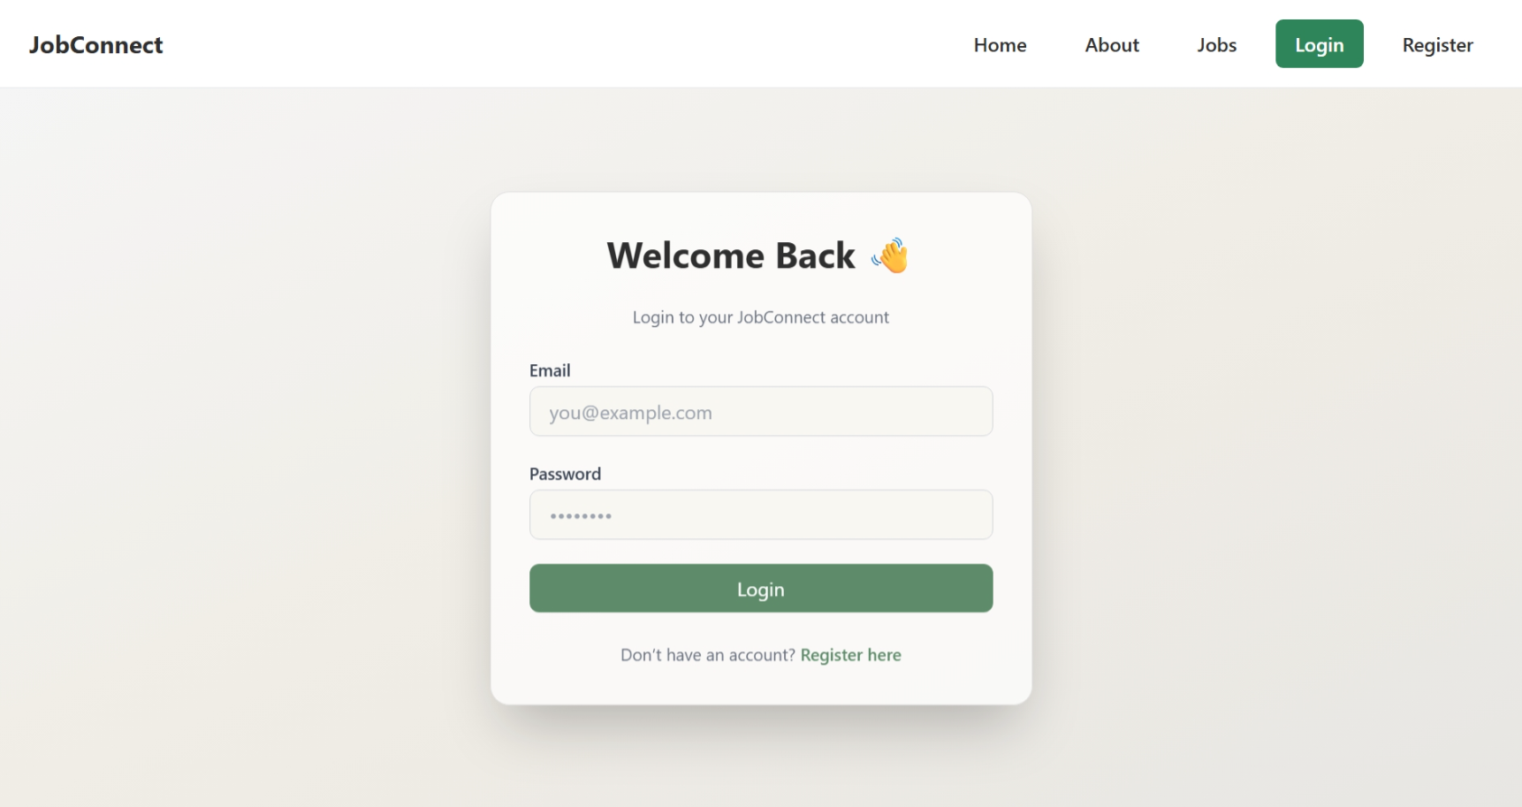

Slide 16
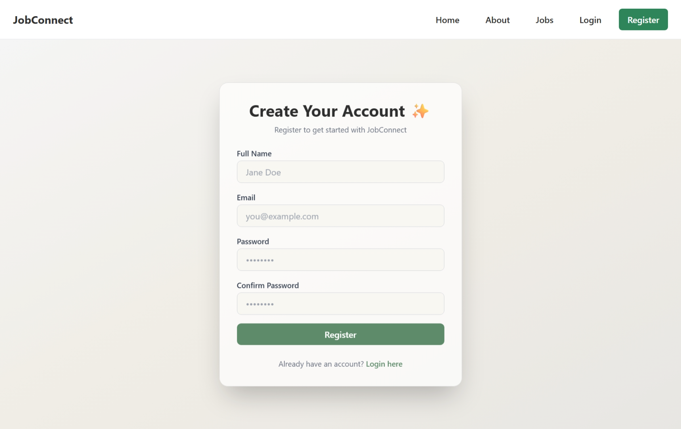

Slide 17
Profile Page
- View and edit user details
- Display job applications submitted
- Conditional rendering based on auth state

Slide 18
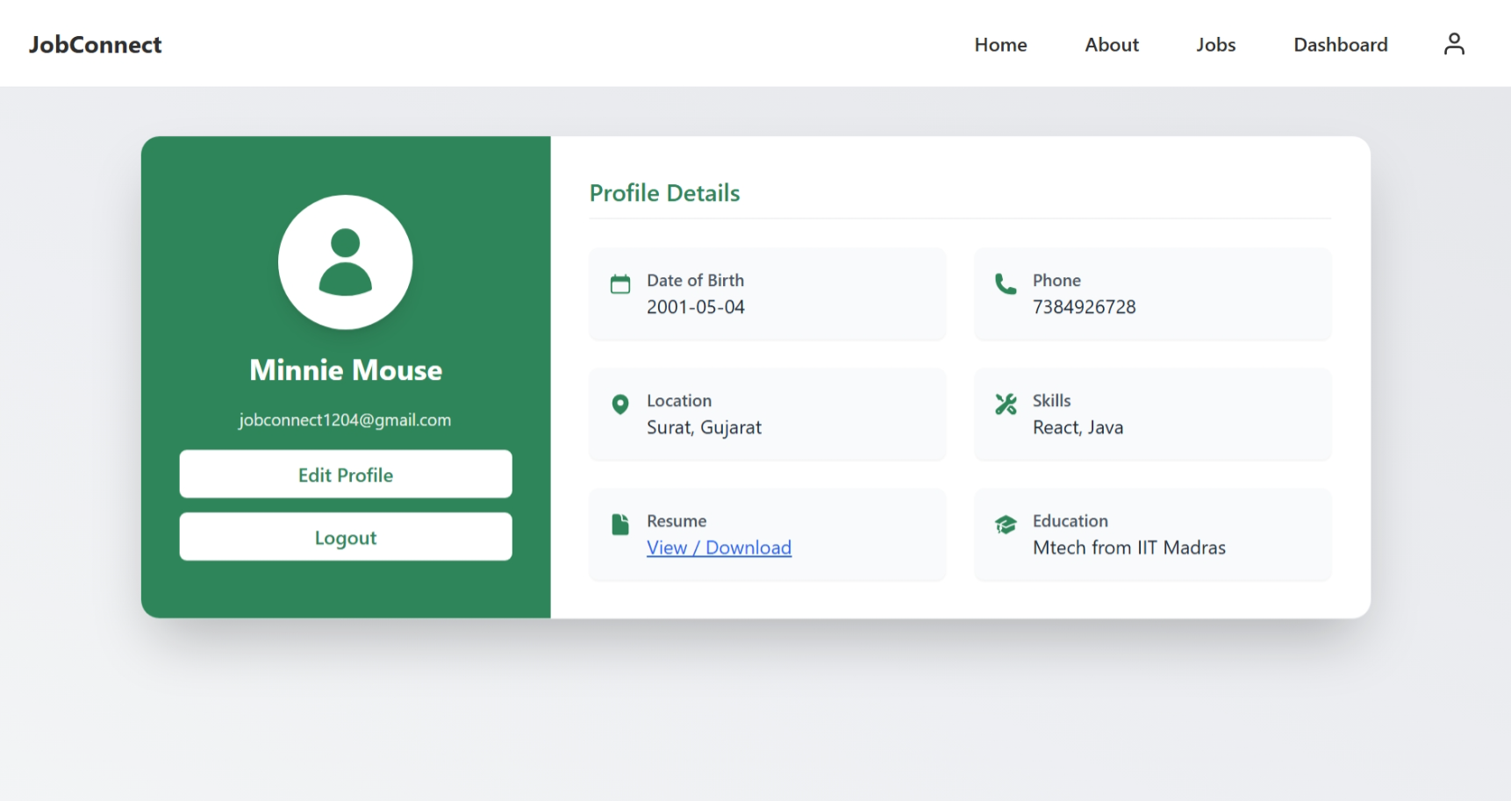

Slide 19
Admin Panel
- Add new job postings
- View all submitted applications
- Quick stats dashboard for job & application count

Slide 20
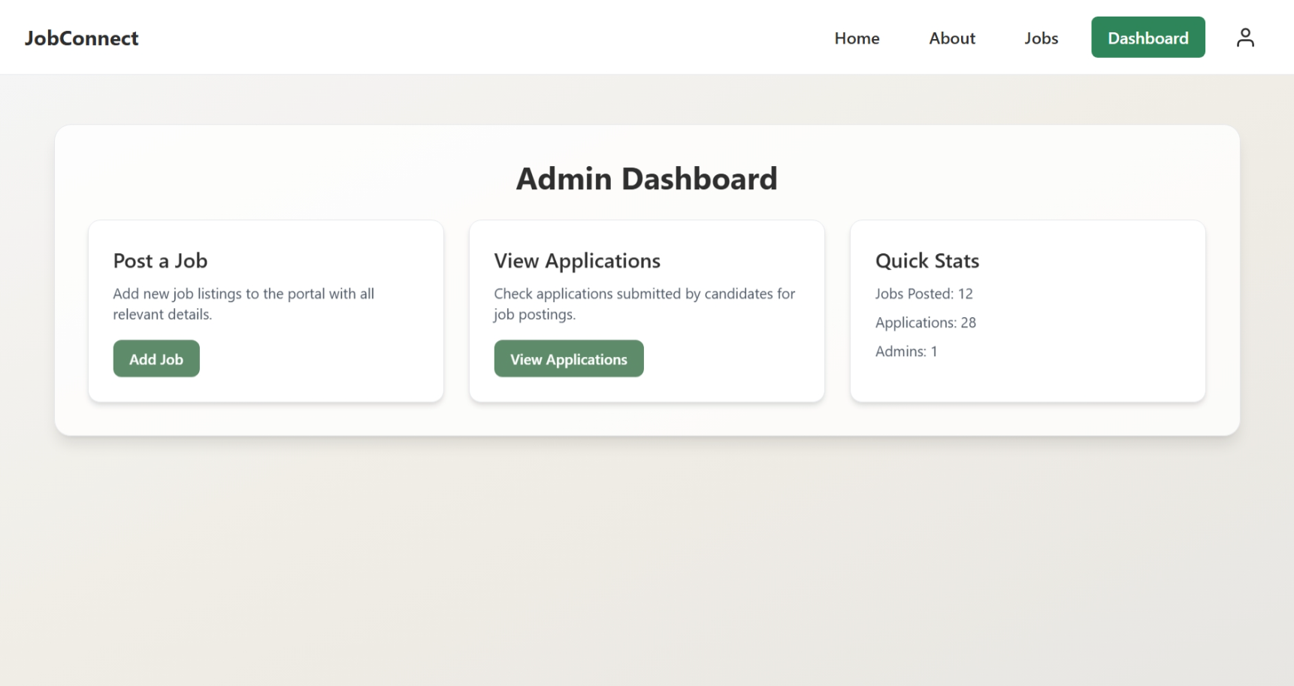

Slide 21
Backend & Database
- Node.js + Express REST API
- MongoDB Atlas for data persistence
- Collections: Users, Jobs, Applications
- Email service using Nodemailer

Slide 22
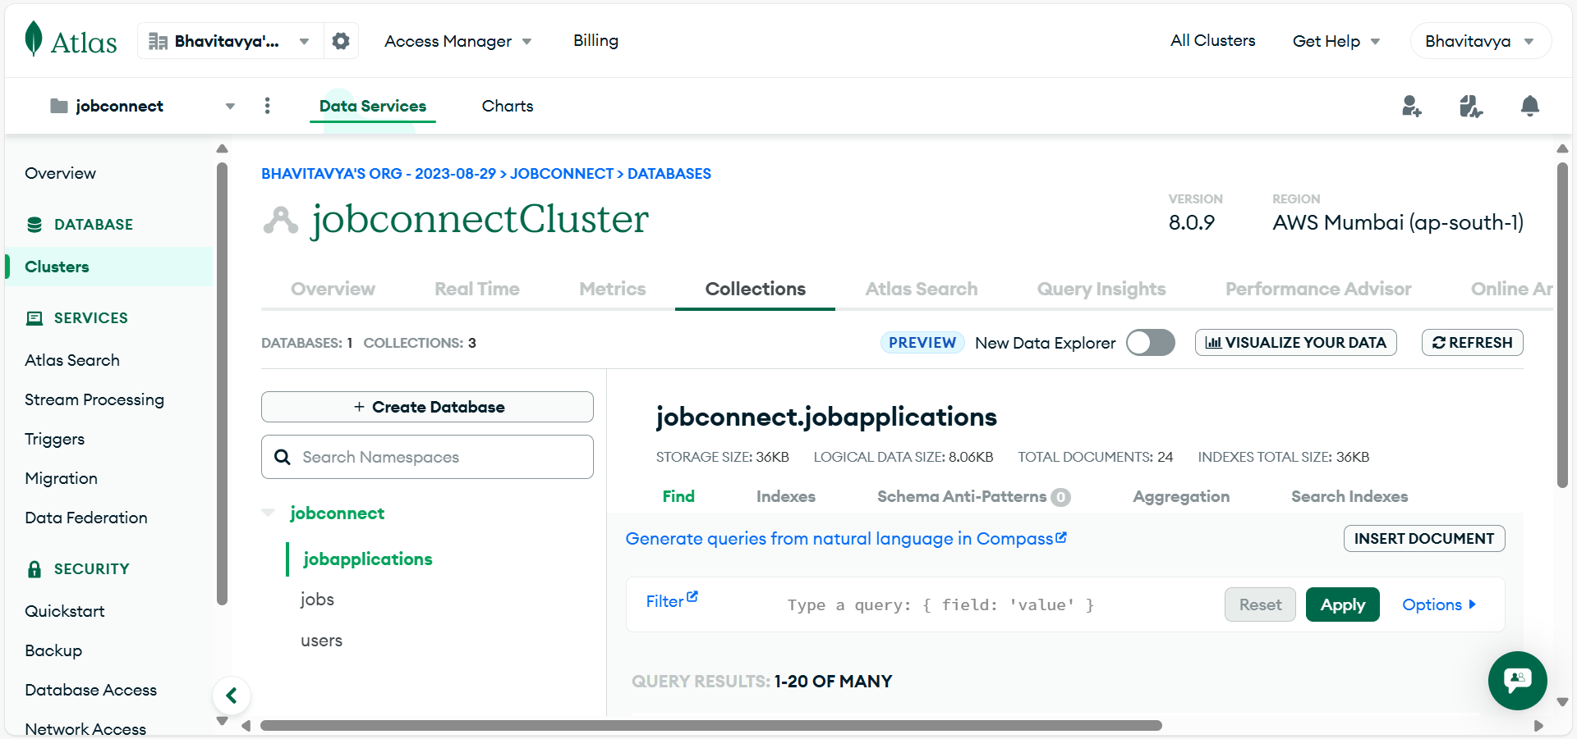

Slide 23
Key Learnings
- Gained full-stack development experience
- Learned JWT-based secure login systems
- Implemented Nodemailer for real-world email workflows
- Practiced clean UI/UX design

Slide 24
Conclusion
Successfully built JobConnect using modern web technologies.
Handled both frontend and backend.
Developed a complete, responsive, and functional job portal.
This project enhanced both technical and project management skills.

Slide 25
THANK YOU

